Slide 1
Teach a Neural Network to Read Handwriting
Submitted by: Vipul Kaushal
ECKOVATION
Course: Machine Learning in Python

Slide 2
Neural networks
Neural networks are biological approach to Artificial Intelligence.
It can have number of layers (single layer/multi-layer perceptron).
The first layer receives input, applies activation, feeds forward the result and outputs the result.
Here in this project we have used Deep Convolution Neural Network(CNN) for handwritten digit recognition.
CNN are neural networks for image data. The convolution layer extracts the features from the image which are further fed to the fully connected Neural Network.

Slide 3
MNIST Dataset
The MNIST database (Modified National Institute of Standards and Technology database) is a large database of handwritten digits that is commonly used for training various image processing systems.
The MNIST database contains 60,000 training images and 10,000 testing images. The images are in .idx3-ubyte binary format.
The set of images in the MNIST database is a combination of two of NIST's databases: Special Database 1 and Special Database 3. Special Database 1 and Special Database 3 consist of digits written by high school students and employees of the United States Census Bureau, respectively.
It can be easily imported using keras.dataset.mnist.load_data() in python.

Slide 4
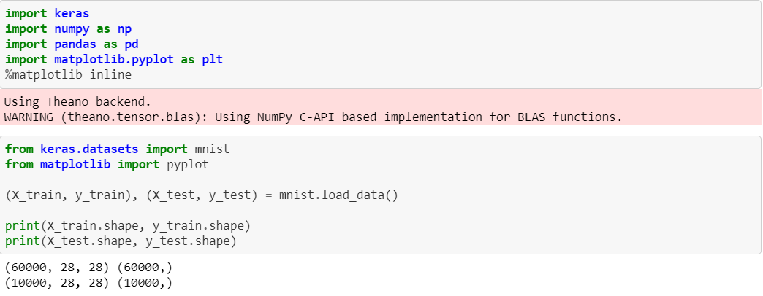
Importing basic libraries and the dataset

Slide 5
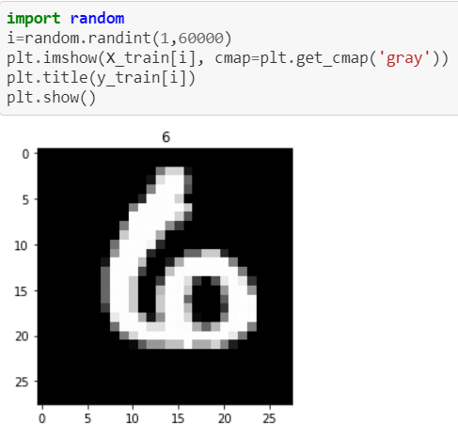
Visualising a mnist image
We have plotted using matplotlib.pyplot.imshow() function.
We have used random here to visualise any random sample from the dataset.
The function plt.get_cmap(‘gray’) plot the image in grayscale format.

Slide 6
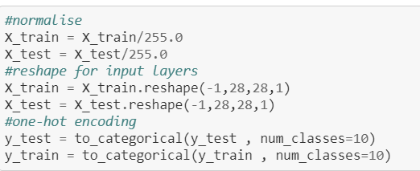
Data pre-processing
Normalise the data for good accuracy, divided by 255(max value for a pixel).
Reshaping the data so as to feed the convolution layer of neural network we will construct further.
One hot encoding for converting the label of an image to a vector of 0s and 1 to ease the prediction process.

Slide 7
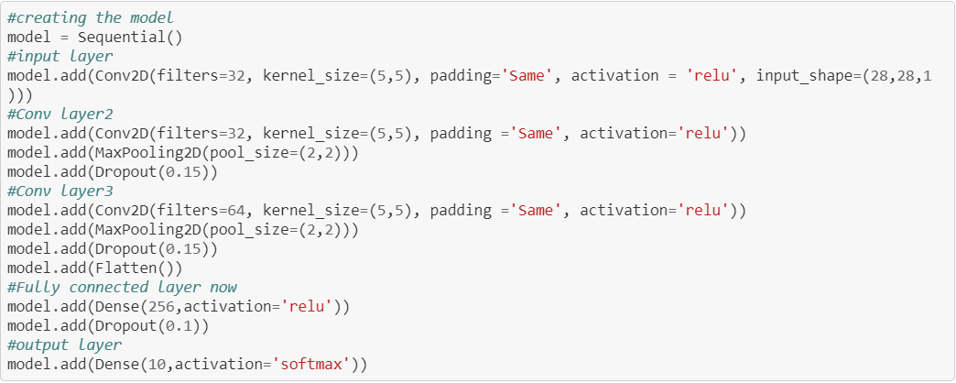
The model strategy
3 Convolution layers were used with padding to extract as many features as we can from the images and max-pooling to enhance the dominant features.
The Dropout function ensures regularisation and no-overfitting prone model.
Then flattened the 2-D output from Convolution layer to 1-D to be able to fed to the dense layer.
Using softmax activation at output layer as it works pretty well when we have more than 2 classes.
INPUT
CONV LAYER
CONV LAYER 2
CONV LAYER 3
FLATTEN
DENSE LAYER 1
OUTPUT LAYER
THE BASIC SEQUENCE OF DATA FLOW IN MODEL

Slide 8
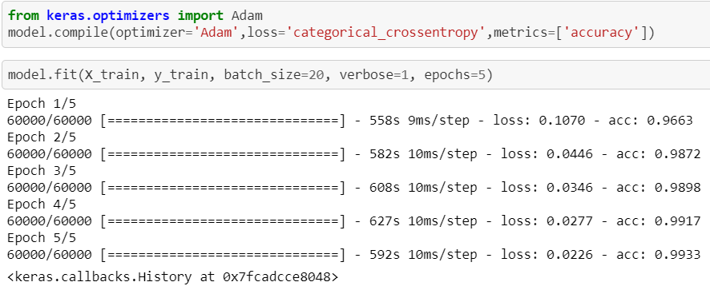
Compiling and training
Using Adam(adaptive moment estimation) optimizer for optimisation.
It is computationally less expensive and an extension to the stochastic gradient descent for updating the weights.
Epochs can be increased for greater accuracy .

Slide 9

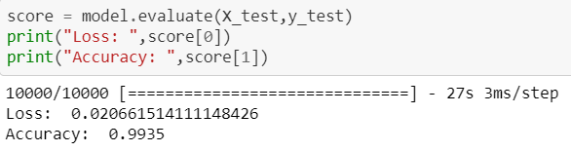
Testing the model

Slide 10
Problems and learnings
A deep intuition of Neural Nets and their functioning was detailed in the course.
The major problem was to decide the architecture of the model.
For the architecture I referred to [1] article which was very intuitive on how to decide number of hidden layers as well as the input nodes in them.
Also some hit and trial is necessary when it comes to Neural Networks.
Another problem was to load the dataset in mnist format, which in [2] I found keras did for us.
Also the visualisation of the MNIST images using matplotlib required the image to be converted to array was learnt.
Next was to choose the correct optimizer and I selected adam about which I learnt from [3].
You can find the code here: https://github.com/avee1998/Teach_Neural_Network_to_Read_Handwriting

Slide 11
References
[1]: HEATON RESEARCH: The number of Hidden Layers and input Nodes in a Layer: https://www.heatonresearch.com/2017/06/01/hidden-layers.html
[2]: PYTHON keras.datasets load examples: https://www.programcreek.com/python/example/103267/keras.datasets.mnist.load_data
[3]: Why Adam Optimizer is robust to hyperparameters: https://stats.stackexchange.com/questions/232719/what-is-the-reason-that-the-adam-optimizer-is-considered-robust-to-the-value-of
Link to the eckovation course I pursued : https://www.eckovation.com/course/machine-learning-value-package?utm_source=clp-banners

